Slide 1
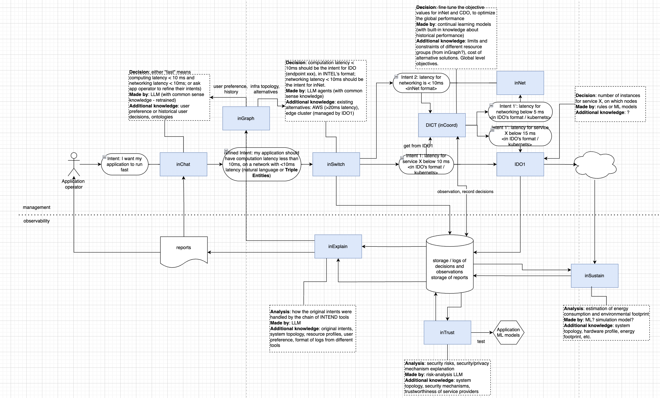
Resources:
Sample intents.xlsx,
Tool MVP checklist.xlsx and
5G4Data sample intents flowchart.

Slide 2



5G4Data – handling of sample intent (inspired by TMForum work on Autonomous Networks)
E2E Latency-Sensitive
User/Enterprise
Latency sensitive stakeholder and Communication service provider using intents (what not how to achieve an objective) to express requirements
Intent
Business
Business Intent Manager
CSP Operations
Intent
Service
Service Intent Manager
Service Orchestration
Successive break down of requirements
RAN
Intent
Transport
Edge and Cloud
Intent
Intent
RAN
Intent Manager
Transport
Intent Manager
Edge Application Manager
Regional Site
Distribution of requirements specific to autonomous domains
Resource
Edge
RAN Management
Optical Transport
Cloud Orchestrator
Notes:
Excerpted from TM Forum IDAN catalyst presentation in Copenhagen
B1: Latency-Sensitive Business Intent
2.1: S1: Latency-Sensitive Service Intent
2.1.1: Send Probe S1-1
2.1.2: Failed Probe
2.1.3: Send new Intent S1-2 (high priority user) - Accepted
2.2: Translate into Service Order
2.3: Generate Resource orders
2.4: Send RAN Resource Intent
2.4.1: R1-1:Set Resource Intent
2.4.2: Show how utility maximises latency and energy efficiency
2.5: Send Transport Resource Intent
2.5.1: R1-2:Set Resource Intent
2.5.2: Show Connectivity (simulator)
2.6: Send Cloud Resource Intent
2.6.1: R1-3:Set Resource
2.6.2: Show VNFs in Edge (IEAM)

Slide 3

UC3 5G4DATA: Intent lifecycle management Open loop (fire and forget)
inChat
Intent life-cycle management (relatively easy)
Specify the intent as a static, predefined goal.
Ensure the intent aligns with system capabilities and operational constraints.
Configure the system to execute the intent as a static rule or schedule.
Manually assess if the intent remains relevant and effective over time.
Manually update the intent if requirements change or retire it if no longer needed.
Business level intent
TMF REST API
Intent management
inSwitch
Service level intent
TMF REST API
inCoord
TMF REST API
Intent management
inOrch
Intent management
inNet
Resource level action/intent
K8s apiserver
NEF/Camara API
K8S
5GC
Open control loop is not good enough for 5G4DATA use-case...
But will be used in first version of MVP

Slide 4
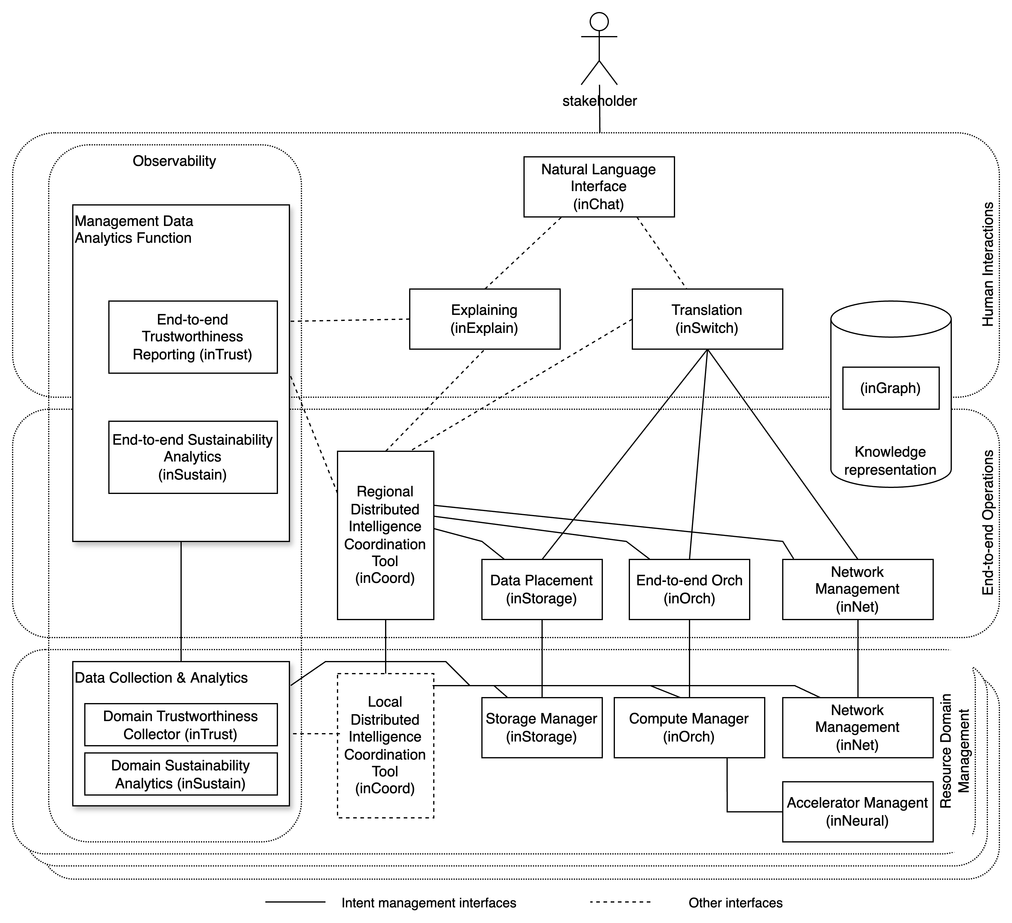
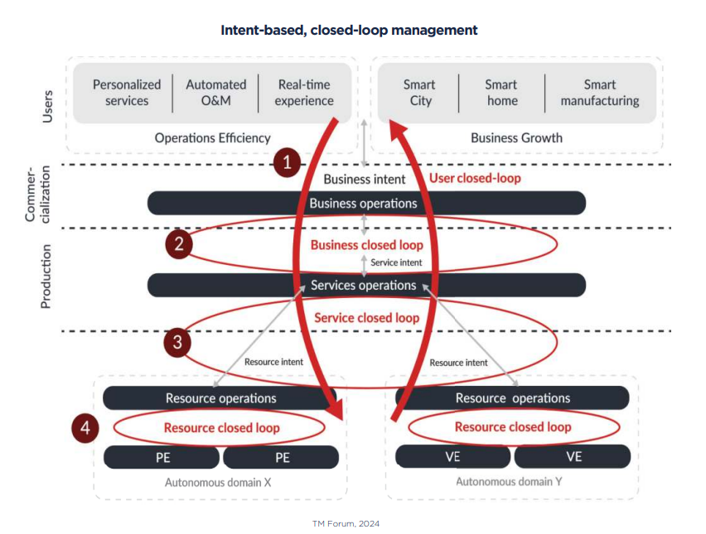
INTEND reference architecture, Agents and the link to TM Forum work on Autonomous Networks

Slide 5
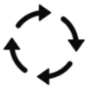
UC3 5G4DATA: Intent lifecycle management Closed loop
Intent management
inChat
Intent life-cycle management (more complex)
Define and capture the high-level goal or outcome desired by the user.
Translate the high-level intent into actionable sub-intents or policies that can be understood by the underlying systems.
Negotiate if (chain of) intents can be accepted
Implement the translated intent.
Continuously monitor the system to ensure the intent is being met.
Continuously refine and optimize the intent's implementation to adapt to changing conditions.
Enable dynamic updates to the intent as business needs or external conditions change.
Conclude or deactivate the intent when it is no longer needed.
Business level intent
Intent reports
Intent management
InSwitch
Service level intents
Intent reports
inCoord
Intent management
inOrch
Intent management
inNet
K8s apiserver
NEF/Camara API
K8S
5GC
TMF REST: Intent API
TMF REST: Reporting API
Closed control loop fits well for 5G4DATA use-case…
Notes:
To be discussed: Is Intent Management functionality a separate entity or an intrinsic part of the tools?

Slide 6
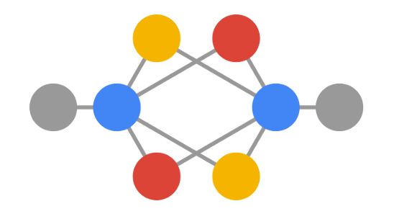
Add lifecycle management as separate entity?
Intent management
inChat
Intent management
inSwitch
IDO
Intent management
Intent management
inCoord
Knowledge Graph(s)
Representation of intents and intent reports
Information about the underlying infrastructure
inNet
K8S
5GC
To be discussed?

Slide 7
User closed loop
Business goal: Optimize performance of a running application
Business intent verbatim: "My retail store AR application is not giving my customers a good experience. It seems to be lagging, possibly due to high latency or poor bandwidth. Please fix it. The AR googles are connected to Telenor 5G network in my store in Tromsø."
Business intent expressed in TMForum ontology:
Target are the responsible tools (inChat, inSwitch?, inGraph?, inCoord?)
Delivery expectation
Fix customer experience for AR application
Reporting expectation
Status of customer experience

Slide 8
Business closed loop
Business intent expressed in TMForum ontology:
Target is the responsible tool (inChat, ...)
Delivery expectation
Fix customer experience for AR application
Reporting expectation
Status of customer experience
Service intents expressed in TMForum ontology:
Target are the responsible tools (inCoord?)
Delivery expectation 1
Deploy AR application in local datacentre
Reporting expectation 1
Status of deployment, Metrics measurements?
Delivery expectation 2
Configure needed latency and bandwidth in network
Reporting expectation 2
Status of configuration, Metrics measurements?

Slide 9
Service closed loop
Service intents expressed in TMForum ontology:
Target are the responsible tools (inCoord?)
Delivery expectation 1
Deploy AR application in local datacentre
Reporting expectation 1
Status of deployment, Metrics measurements?
Delivery expectation 2
Configure needed latency and bandwidth in network
Reporting expectation 2
Status of configuration, Metrics measurements?
Resource intent 1
Target are the responsible tools (inOrch)
Delivery expectation 1
Deploy AR application as a POD in a K8s Node
Reporting expectation 1
Status of deployment, Metrics measurements?
Resource intent 2
Target are the responsible tools (inNet)
Delivery expectation
Configure a localized slice with 10 ms latency and 300 Mb/s bandwidth
Reporting expectation
Status of configuration, Latency and bandwidth measurements

Slide 10
Resource closed loop
Perform operations to execute resource intents

Slide 11
Let us start creating lifecycle management for intents!
We would like to invite all tool owners to participate
We have created a github repo for this endeavor and would encourage that a designated partner (SINTEF?) acts as lead for the development (our initial explorations are already in the repo)
We do believe that this would generate something that is generic and can be used across use-cases
It will help us establish exactly what an intent is (usage of an ontology, could be TM Forum´s ontology, something we create or a mixture, e.g. needed parts from TM Forum ontology and extensions for our use-cases)
It will help us establish the flow between tools and what we need to store in a knowledge base (lifecycle management is the glue :-) )

